Slide 1
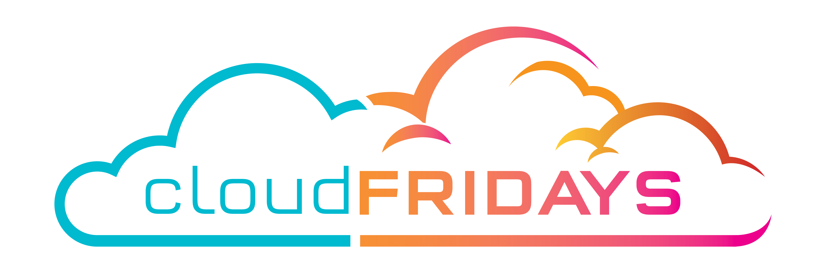

Azure Boards
Plan, track, and discuss work across your teams
Herman Swart
Project Manager – Tangent Solutions

Slide 2
Azure Boards Basics
Track work with Kanban boards, Backlogs, Team dashboards and Custom reporting
Connected from idea to release
Scrum ready
Built for insights
https://azure.microsoft.com/en-us/services/devops/boards/

Slide 3
Azure Boards - Getting Started
Create a Microsoft account and sign up
Open Azure Boards and choose Start free with Boards
https://azure.microsoft.com/en-us/services/devops/boards/
An organization is created based on your sign-in account name
A project is created based on your sign-in account name
Note: Choose Start Boards free with GitHub. If you're already part of an Azure DevOps organization, choose Sign in to Azure DevOps

Slide 4
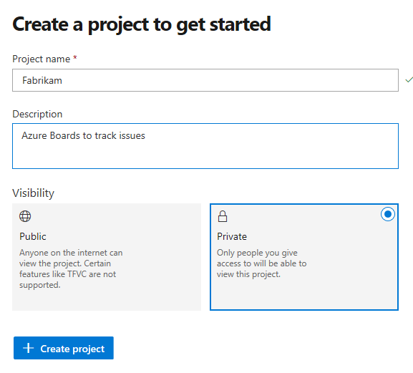
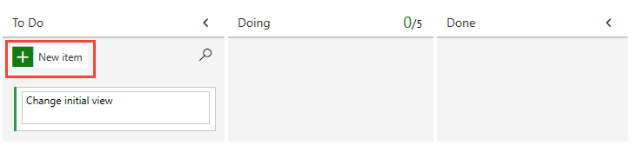
Azure Boards - Create a Project
Enter a name for your project, select the visibility, and optionally provide a description
When your project has been created, the Kanban board automatically appears
You can add and invite others to work on your project by adding their email address to your organization and project
From your project web portal, choose the Azure DevOps icon, and then select gear icon Organization settings

Slide 5
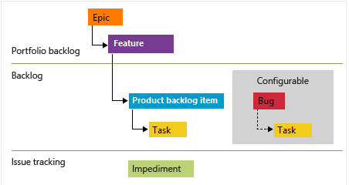
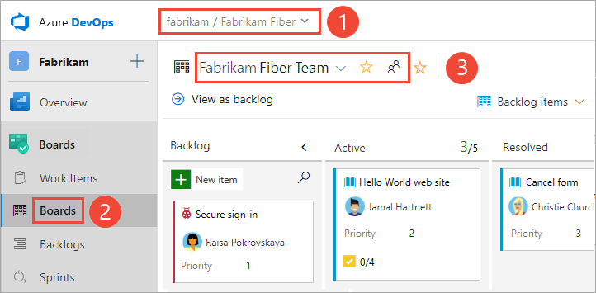
Azure Boards - Plan and track work
Choose one of the following four system processes—Agile, Basic, Scrum, or Capability Maturity Model Integration (CMMI)
The Scrum process provides several work item types—product backlog items, tasks, bugs, features, and epics
A Kanban board is provisioned with the addition of each project and each team
The Features Kanban board is the best tool for quickly adding features and product backlog items that are children of those features

Slide 6
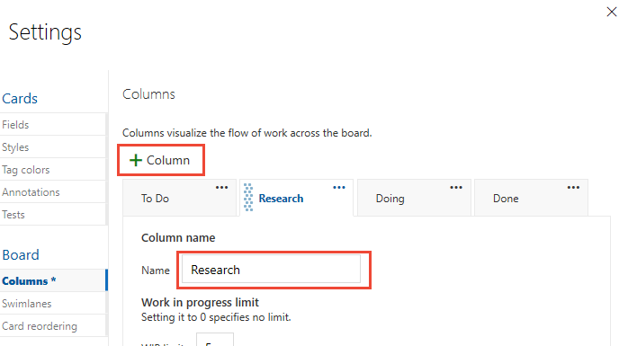
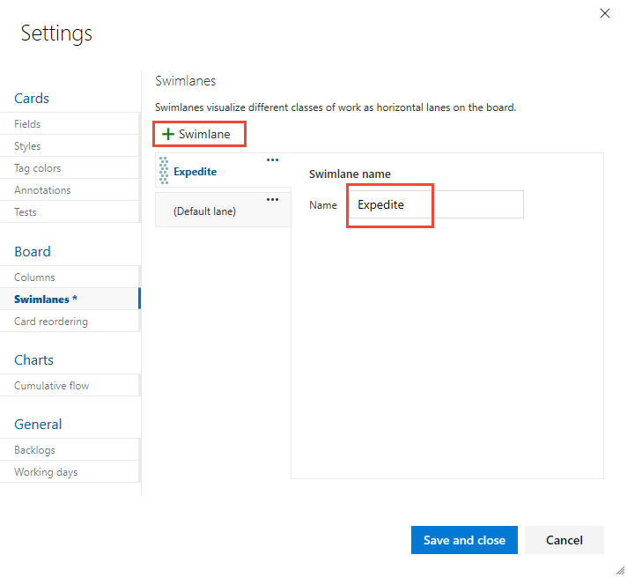
Azure Boards – Customize Your Board
Each team can customize their Issues and Epics boards and sprint Taskboards
Choose the gear icon to configure the board setting settings
Swimlanes appear as rows within the Kanban board and provide yet another way to categorize work you want to track
To add a swimlane, choose Swimlanes tab and choose plus icon Swimlane, and then specify the name

Slide 7
Azure Boards – Manage Projects
Add users to your project. To assign users to issues or tasks, you need to add them to your project.
Share your project vision. To support people who'll contribute to your project, provide them some directions via the project summary page, or through your project wiki.
Define area and iteration paths. If you work with Scrum methods or want to time-box your issues and tasks, you'll want to define Iteration Paths.
Customize your issues or tasks. If you need additional fields to track data, or other type of work item, you can customize your process.

Slide 8
Azure Boards – Quick setup

